Slide 1
135 years of
Wisdom, Devotion, Acheivement
for Real. Strong. Women.

Slide 2
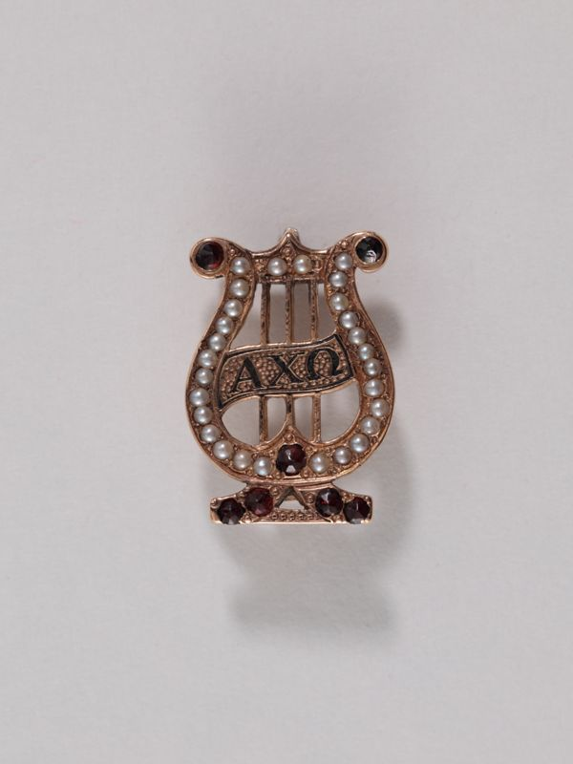
The Lyre is adopted as the Badge in 1885.
Bertha Deniston purchases the first one.

Slide 3
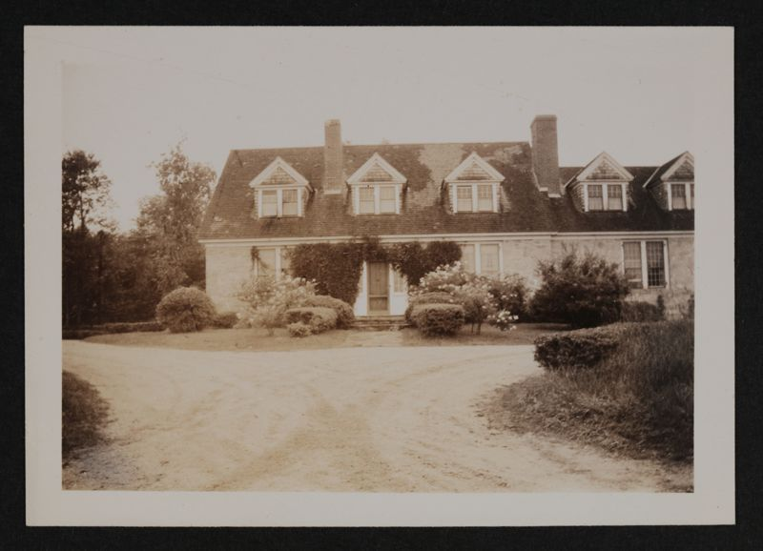
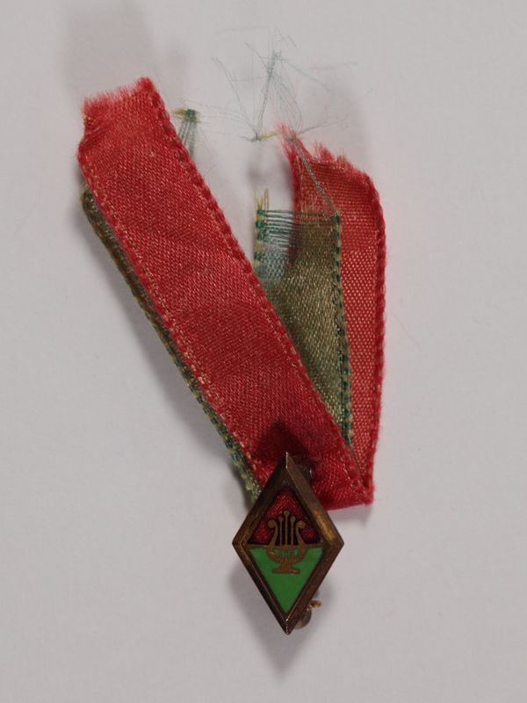
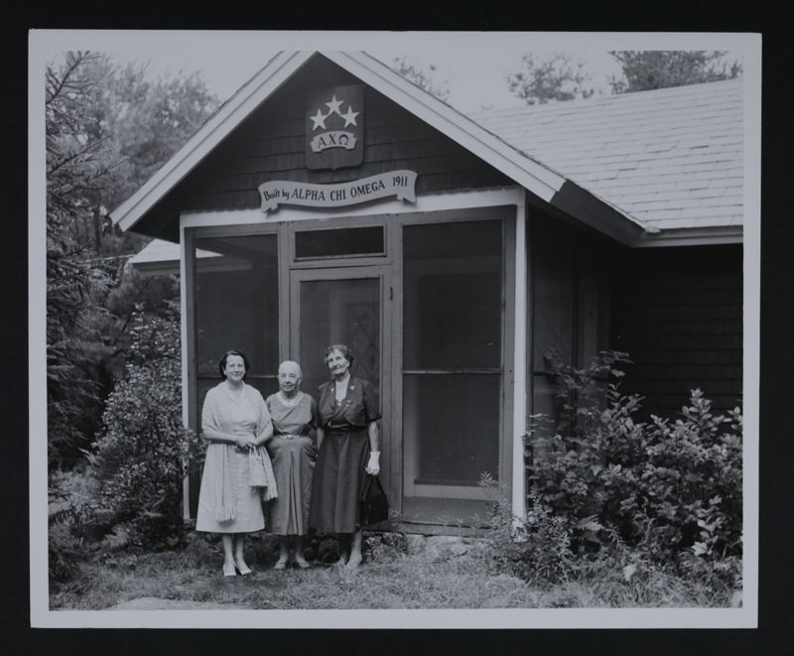
The Pledge Pin is adopted at the 1900 National Convention. Before this time all pledges wore Scarlet and Olive Green ribbons.
1907 Alpha Chi Omega begins it’s first altruistic project in support of the MacDowell Colony
1911 AXO builds Star Studio

Slide 4
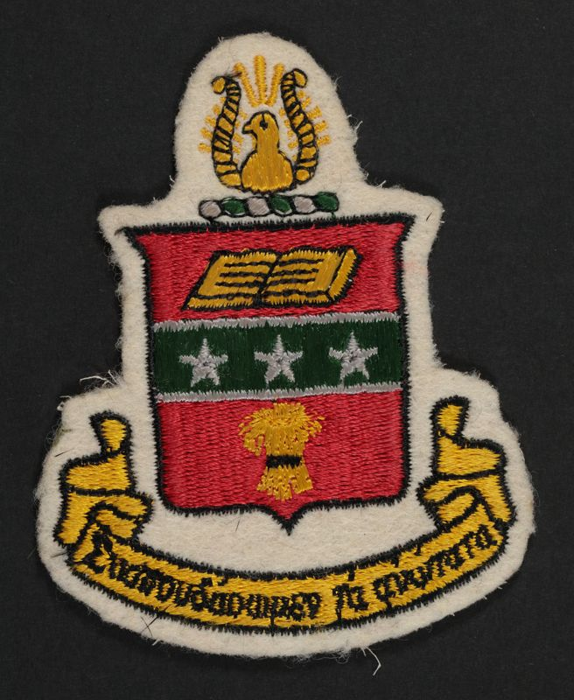
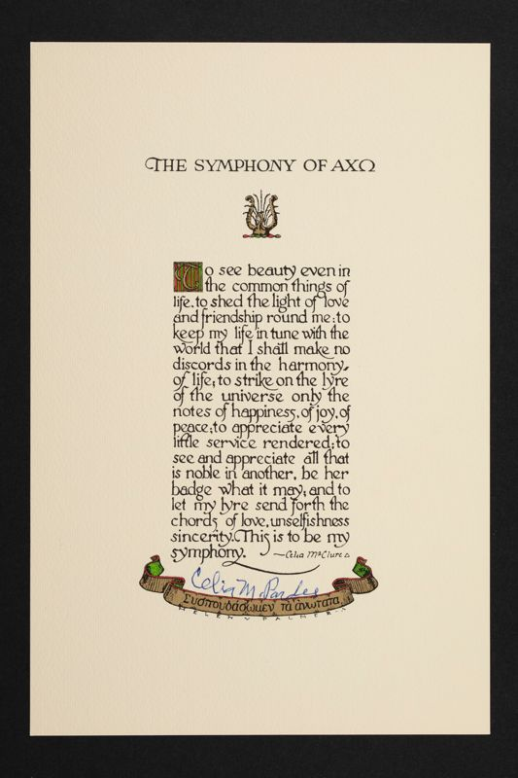
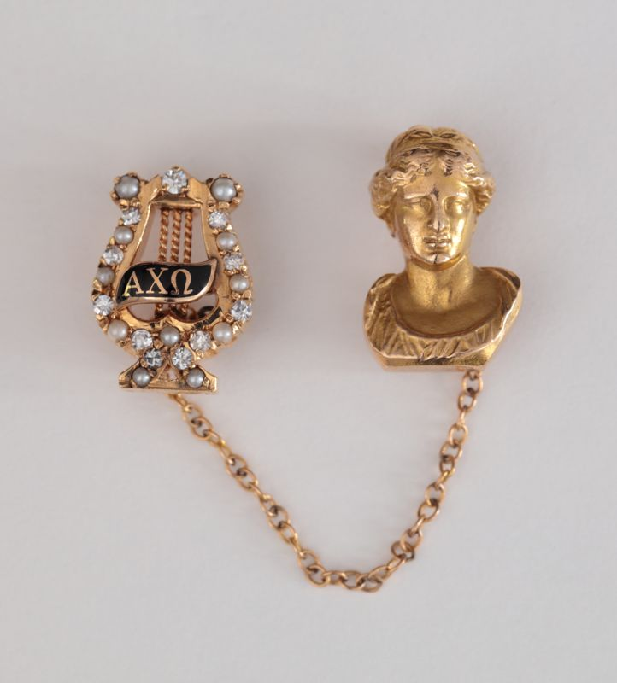
1908- Coat of Arms Adopted at National Convention
- The Initiation Ceremony is Adopted at National Convention. Hera is Adopted as our Patron Goddess
1914- The Symphony is Adopted at National convention

Slide 5
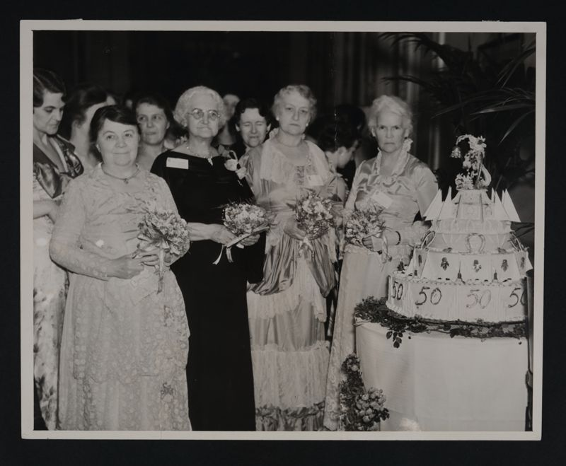
Bertha, Estelle, Nellie and Olive
1935 Golden Jubilee Convention. Four Founders in attendance.

Slide 6
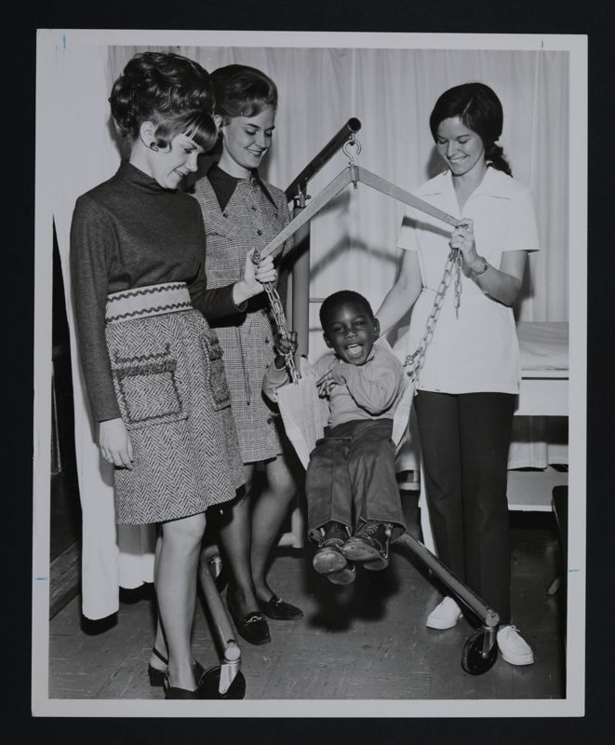
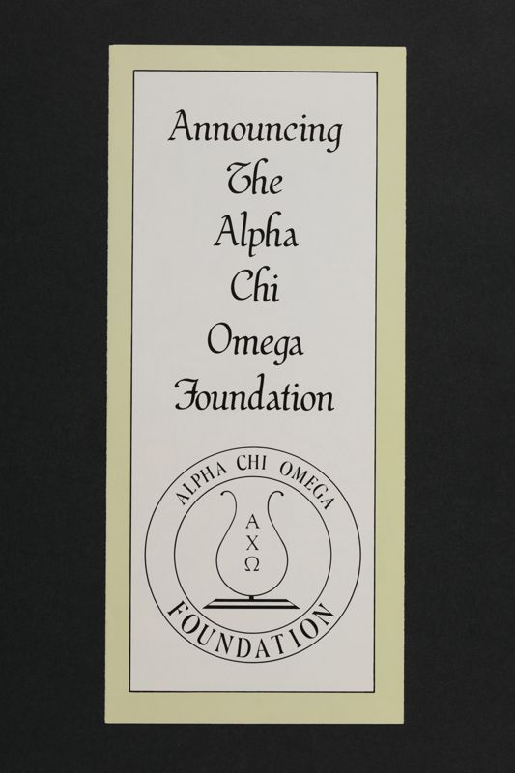
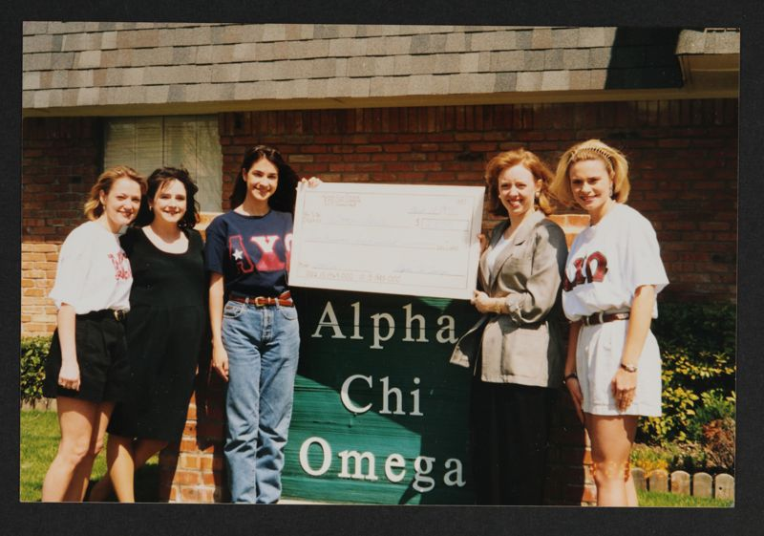
Altrusim through the years
1942 NURSERY SCHOOLS
Alpha Chi Omega establishes nursery schools in Detroit and Milwaukee for children of war workers and service personnel.
1947 National Society for Crippled Children, Cerebral Palsey division (now Easter seals) is adopted as a National Altruistm Project
1973 CYSTIC FIBROSIS FOUNDATION
The Cystic Fibrosis Foundation is added as a national altruism project.
1978 The Alpha Chi Omega Foundation is approved at the National Convention
1992 DOMESTIC VIOLENCE AWARENESS
A new national altruism is adopted with a two-pronged focus: support of victims of domestic violence and programs to education women to avoid becoming victims

Slide 7
Membership Development in the New Millennium
2001 IMPACT Alpha Chi Omega ins introduced as a Leadership Development program for collegians.
2001 Kristin’s story presentations begin in partnership with Delta Delta Delta to educate college women about date rape and depression
2011 ASTP AND INTUNE
Alpha Chi Omega launches rotational programs including the Alcohol Skills Training Program (ASTP) and InTune, ensuring that every collegiate chapter member receives a member development opportunity facilitated in person by an expert facilitator. The rotational programs that are later launched include REPRESENT in 2012 and Let's Talk Love in 2016.
2012 MYJOURNEY
Alpha Chi launches the MyJourney program, a four-year member development program. MyJourney includes the Dedication, which is the new member education program, as well as life-skills based, relevant programs for all members.
2016 WOMEN & WISDOM
The Women & Wisdom program, an online mentoring program for collegians and alumnae, is launched

Slide 8
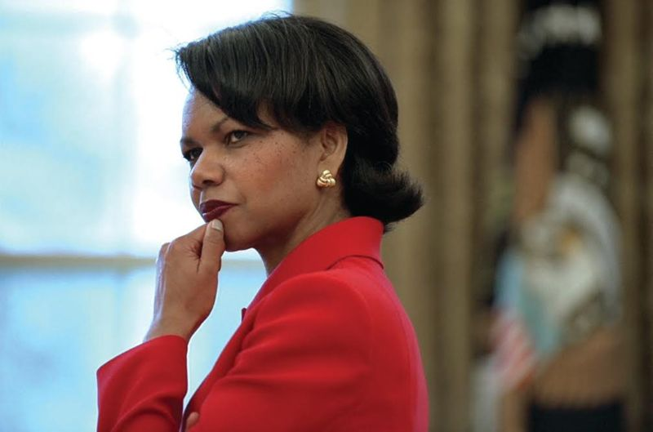
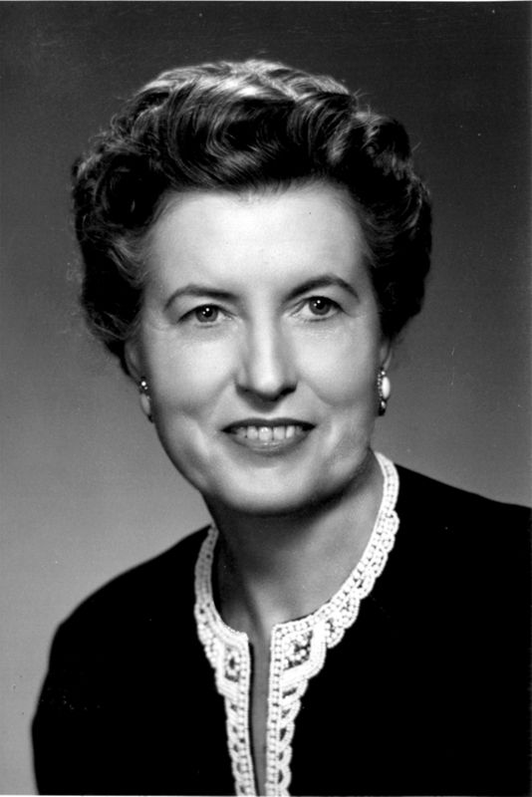
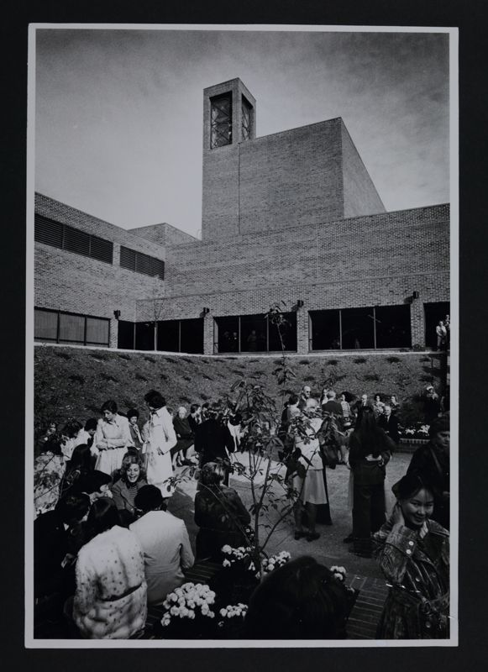
AXO FUN FACTS
This is Burnette Grimes Jones (Omega) Washington State
She served as National President 1957-1960.
The scholarship fund that we support is named after her!
In 2005,Dr. Condoleezza Rice (Gamma Delta) University of Denver, becomes United States Secretary of State.
In 1976 a bell tower was constructed at DePauw University and dedicated to our seven Founders.
Alpha Chi Omega reached 1000,000 initiates in 1981.We then reached 200,000 initiates in 2006!

